Slide 1
CS7/8745 : Machine Learning Instructor: Salim Sazzed Department of Computer Science University of Memphis

Slide 2
Recap

Slide 3
Probability:
Probability is a fundamental concept in mathematics and statistics that measures the likelihood of an event occurring.
In simpler terms, probability answers the question: "How likely is it that something will happen?”
Probability = Chance of an event
Values between 0 and 1 represent the degree of uncertainty.
A probability of 0.5 means that an event has a 50% chance of occurring, while a probability of 0.25 indicates a 25% chance, and so on.

Slide 4
Sample Space: It represents the complete set of potential results that can occur when an experiment is performed. For example, when rolling a six-sided die, the sample space consists of the numbers 1 through 6.
Event: An event is a specific outcome or a collection of outcomes from the sample space. Like getting 4 after rolling a die.
Probability Calculation: The probability of an event A, denoted as P(A), is calculated as the ratio of the number of favorable outcomes (those in event A) to the total number of possible outcomes in the sample space.
P(A) = Number of Favorable Outcomes / Total Number of Possible Outcomes
Probabilities are typically expressed as numbers between 0 and 1, where 0 indicates that an event is impossible, 1 indicates that an event is certain, and values in between represent varying degrees of likelihood.

Slide 5
Rolling a Fair Six-Sided Die:
Sample Space: {1, 2, 3, 4, 5, 6}.
Event: Rolling an even number (2, 4, or 6).
Number of Favorable Outcomes to event : 3 ( when we get 2, 4, or 6).
Total Number of Possible Outcomes: 6
Probability: P(Even number) = 3/6 = 1/2 = 0.5 (50%).

Slide 6
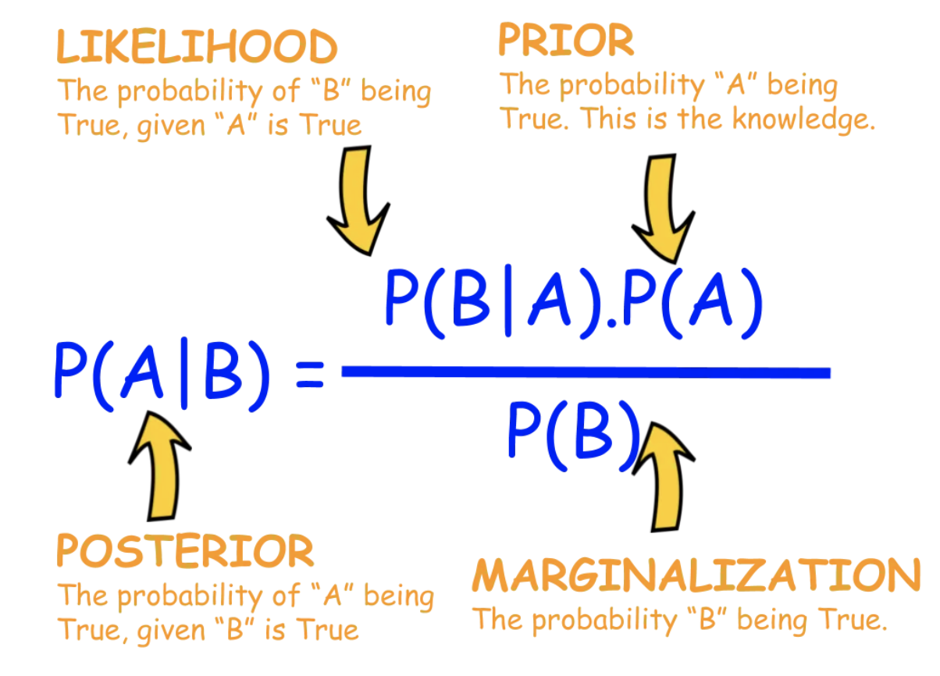
Bayesian Statistics
Lets consider two events A and B.
Conditional Probability: P(A∣B) is the probability of event A given event B.

Slide 7
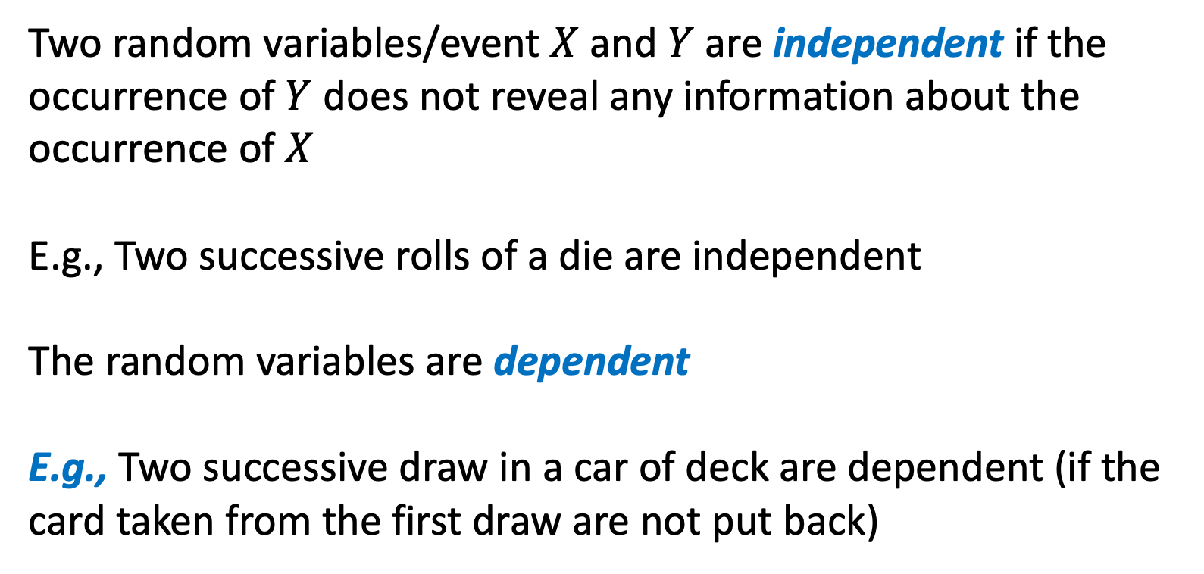
Two random variables/event $X$ and $Y$ are independent if the occurrence of $Y$ does not reveal any information about the occurrence of $X$
E.g., Two successive rolls of a die are independent
The random variables are dependent
E.g., Two successive draw in a car of deck are dependent (if the card taken from the first draw are not put back)
Slide credit: Jeff Howbert — Machine Learning Math Essentials

Slide 8
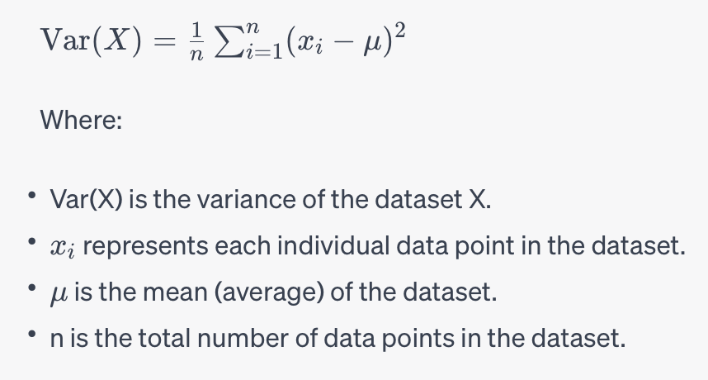
Here's how you calculate the variance of a dataset:
Calculate the mean (average) of the dataset.
For each data point, subtract the mean from that data point.
Square the result of each subtraction.
Calculate the average of these squared differences.
Mathematically, the formula for variance (denoted as Var) is as
X={85,90,88,92,78}

Slide 9
New Topics

Slide 10
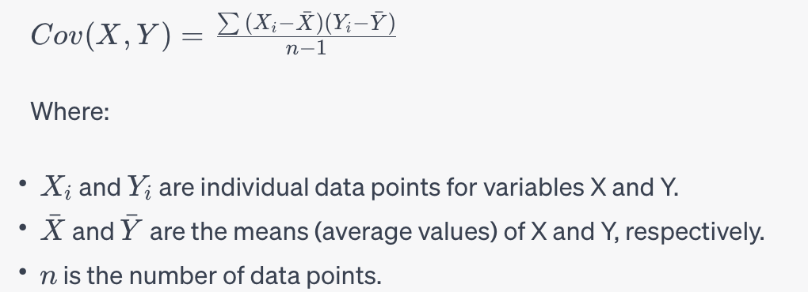
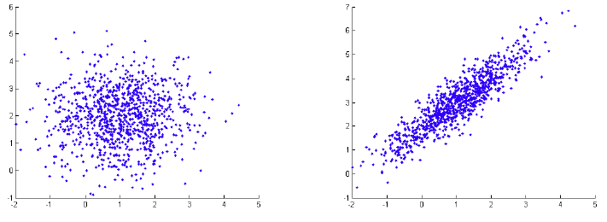
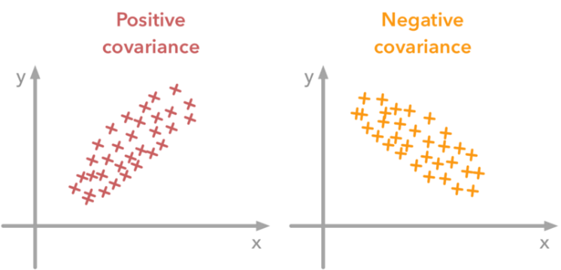






Covariance quantifies the degree to which two random variables change together.
In covariance only sign matters. A positive value shows that both variables vary in the same direction and negative value shows that they vary in the opposite direction.
Let $X=\left[x_{1}, x_{2},…x_{n}\right]$
Let Y $=\left[y_{1}, y_{2},…y_{n}\right]$
$$Y$$
No covariance
$$Y$$
High covariance
$$X$$
$$X$$

Slide 11
Given two datasets, X = [2, 4, 6, 8, 10] and Y = [1, 3, 5, 7, 9], calculate the covariance between X and Y.
1. Compute mean of X and Y
2. Use the following formula-

Slide 12
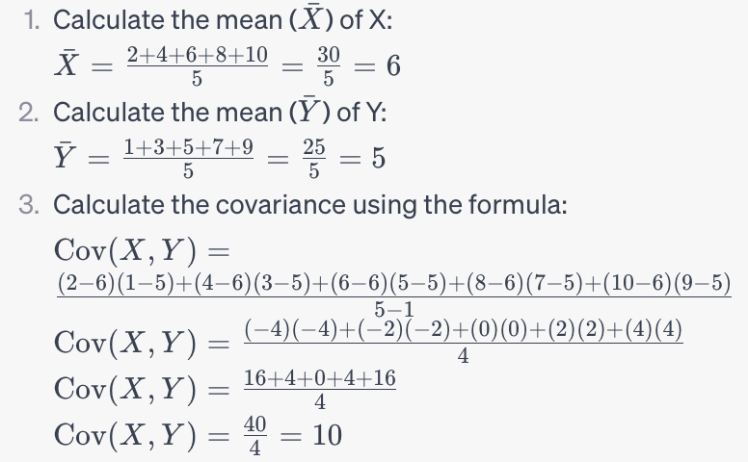

Slide 13
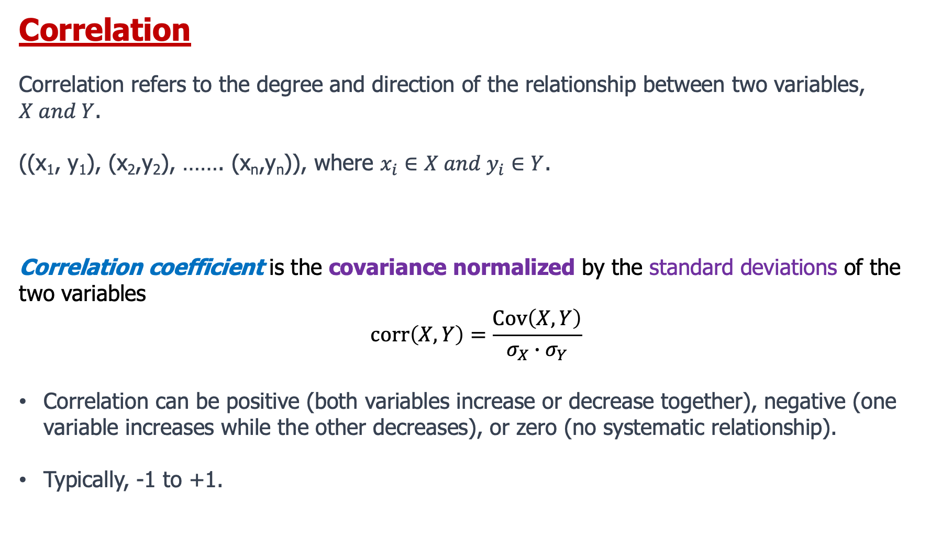
Correlation
Correlation refers to the degree and direction of the relationship between two variables, $X and Y$.
((x₁, y₁), (x₂,y₂), ……. (x_{n},y_{n})), where $x_{i}∈X and y_{i}∈Y$.
Correlation coefficient is the covariance normalized by the standard deviations of the two variables
$$corr\left(X,Y\right)=\frac{Cov\left(X,Y\right)}{σ_{X}∙σ_{Y}}$$
Correlation can be positive (both variables increase or decrease together), negative (one variable increases while the other decreases), or zero (no systematic relationship).
Typically, -1 to +1.

Slide 14
A
B
C
D
E
F

Slide 18
Data for machine learning

Slide 19
Data Modalities
In machine learning, "modalities" refer to different types or modes of data, each representing a distinct aspect of information.

Slide 20
Text Modality
Text data includes natural language text in the form of documents, articles, reviews, and more.
Text data is characterized by its unstructured nature, meaning that it lacks a predefined data model or organized structure like that found in numerical or tabular data.
Natural Language Processing (NLP) techniques are used to process and analyze text data.

Slide 21
Examples:
Documents: This can include articles, books, reports, emails, chat logs, and more.
Social Media Posts: Tweets, Facebook posts, comments, and other forms of social media content.
Web Pages: Content from websites, including articles, blog posts, and forum threads.
Emails: Both individual emails and email threads.
Reviews: Customer reviews of products or services, found on websites like Amazon, Yelp, or TripAdvisor.
News Articles: Articles from newspapers, online news outlets, and magazines.
Medical Records: Patient records, clinical notes, and medical reports.
Legal Documents: Contracts, court transcripts, and legal briefs.
Sentiment Analysis Data: Data labeled with sentiments (positive, negative, neutral) for tasks like sentiment analysis.
Chat Logs: Conversations between individuals in messaging platforms or chat applications.

Slide 22
Image Modality
Image data consists of visual information, typically in the form of 2D or 3D arrays of pixels.
Convolutional Neural Networks (CNNs) are commonly used to analyze and extract features from image data.

Slide 23

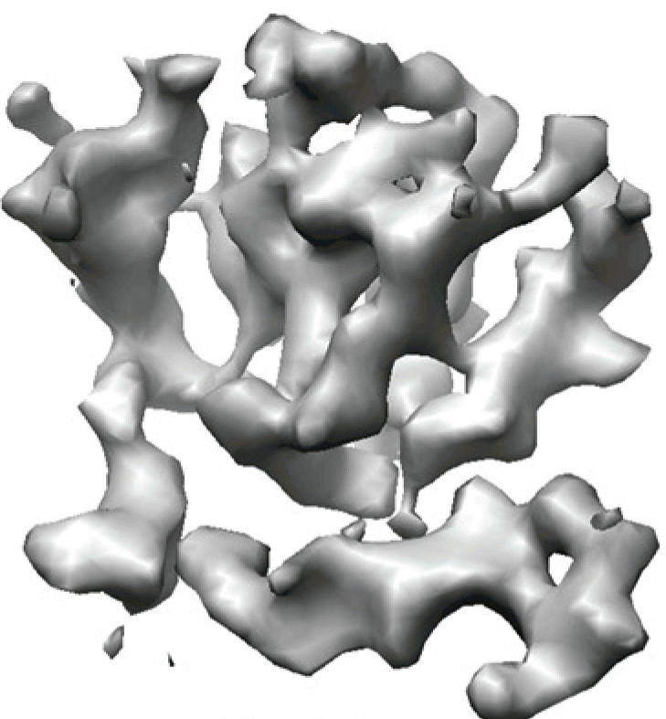
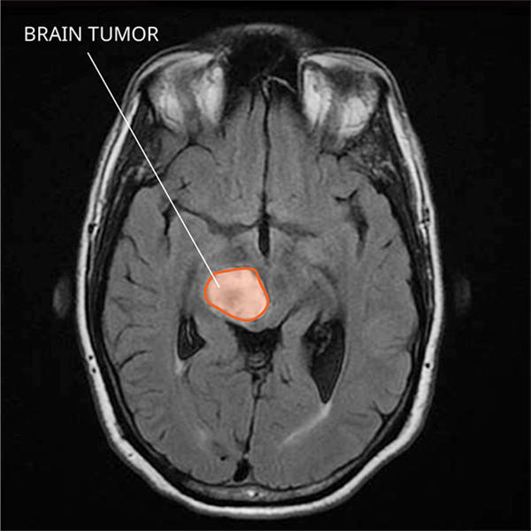
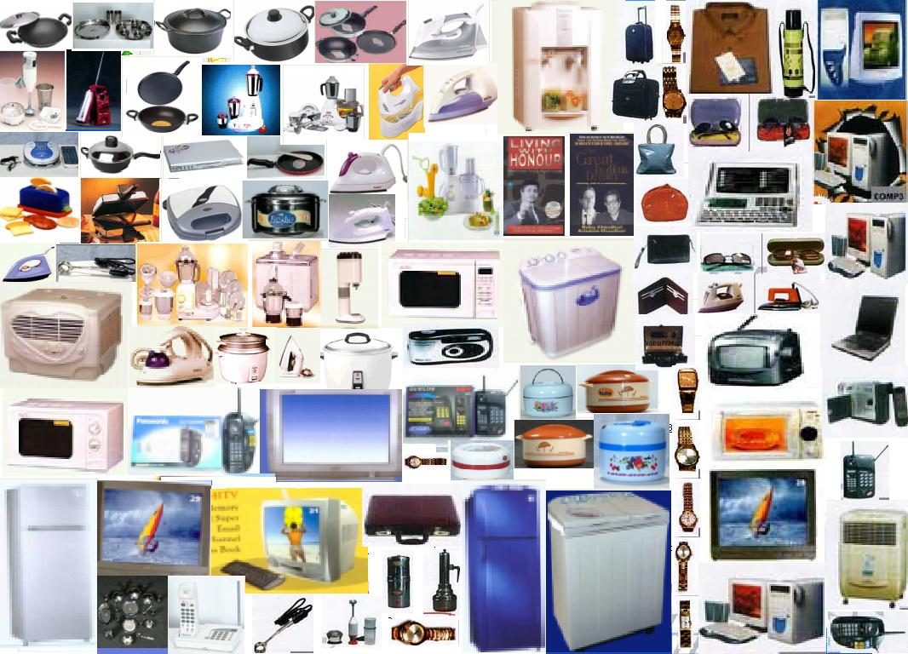
Some examples:
Remote sensing data
Ecommerce product data
Biological data
medical imaging data

Slide 24

Audio/Speech Modality
Audio data represents sound information, often recorded as waveforms.
Techniques such as spectrogram analysis and audio processing are used for feature extraction and analysis.

Slide 25
Time Series Modality:
Time series data is collected or recorded over time at regular intervals.
Each data point in a time series is associated with a specific timestamp or time period, making it a sequence of data points ordered chronologically.
Time series data is widely used in various fields, including finance, economics, environmental science, engineering, and more, to analyze and make predictions based on temporal patterns and trends.

Slide 26
Examples:
Financial Forecasting: Predicting stock prices, currency exchange rates, and economic indicators.
Demand Forecasting: Forecasting product demand for inventory management.
Environmental Monitoring: Analyzing temperature, humidity, pollution levels, and weather patterns over time.
Energy Consumption: Modeling and predicting electricity and energy usage.
Healthcare: Monitoring patient vital signs and disease progression.
Industrial Processes: Monitoring and optimizing manufacturing processes.
Traffic and Transportation:
https://www.youtube.com/watch?v=_oj4uCIvOeQ

